Slide 1
Data Center design – Components
Components in Data Center design
Design of Data center depends upon the various components which are categorized under two major category.
Physical Infrastructure of Data Center
Computing components

Slide 2
Physical Infrastructure of Data Center
Data Center physical components can be categorized as following.
Power
Cabling
Fire and Security
Cooling
Racks and Physical structure
Physical Components forms the backbone of Data Center design and should be viewed as whole rather than individually.

Slide 3
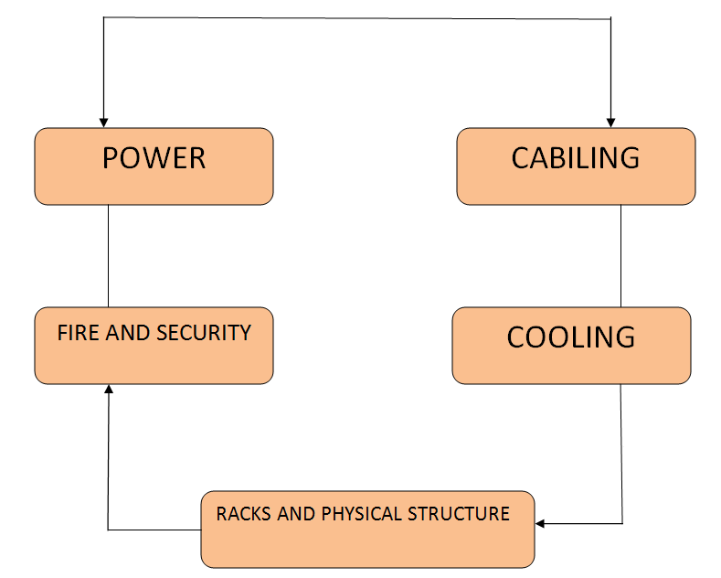
Physical Infrastructure of Data Center
Power is needed to keep all equipment in data center up and running
Data Center should have redundant electricity and also power backup
Keeping UPS ensures that we have uninterruptable power supply and
quality remains constant even when there is any power fluctuations.
Data Center has fire safety system to prevent them from internal or
external fires
Data Center even have range of security devices to limit the access to it.

Slide 4
Physical Infrastructure of Data Center
As computing system emits lot of heat hence Data Center requires very efficient cooling system
Cooling system prevents the overheating of computing system and hence its crash.
Cooling system is generally a chilled AC room to cool the computing systems
One of the main purpose of Data Center is to host Physical server and Racks.
Physical server and Racks are hosted in specific configuration to maintain optimized cooling.
Cabling is one aspect that the network architecture should take precaution when installing them.
Cabling should be done in manner keeping in mind that it needs space for server In/Out.
While Cabling Architect need to keep in mind future expansion and easy to make changes option.

Slide 5
Data Center design – Components
Components in Data Center design
Design of Data center depends upon the various components which are categorized under two major category.
Physical Infrastructure of Data Center
Computing components

Slide 6
Computing components of Data Center
Computing components of Data Center can be categorized as below
Servers ,Storage devices ,Network devices ,Cables etc.
Network Connectivity
Monitoring systems
Policies and Procedures

Slide 7
Computing components of Data Center
Fundamental of Designing a data center is hosting up of Physical servers ,Storage devices ,Network devices and the cables.
These Physical servers can be of any use and may serve different purpose hence are critical to Data Center design
They should be placed in such a manner that its easily accessible to IT Personal on the site.
We have network devices like switches ,routers ,hubs etc. that are part of Data Center as per design.
Density of Data Center define the number of Network components required per rack.
Monitoring system is required in data Center to monitor Temperature ,Humidity ,Water ,Power failure and equipment failure.

Slide 8
Computing components of Data Center
Monitoring is done through well placed alarms which triggers upon change in environmental conditions of Data Center.
Data Center security personal and IT Data manager has the responsibility of ensuring that small alert should not be turn into big business loss if left unattended.
Data Center also have set of Policies and Procedures to maintain efficiency within the facility.
Some of the Policies and Procedures that are commonly used across Data Center are
Role Definitions
Policies
Procedures

Slide 9
Computing components of Data Center
Role Definitions
Everyone who is visiting Data Centre should be part of either of any roles.
Data Center Employee
Authorized Staff
Authorized Vendor
Visitors.

Slide 10
Computing components of Data Center
Policies
Data Center should have policies defined as below
Access Policies
All person who access Data Center should have proper authorization
Visitors must adhere to visitor guidelines
All person must wear organization ID
All person must sign in/out while access Data Center
Authorization of access should be verified on timely basis.

Slide 11
Computing components of Data Center
Equipment based policies
A form must be filled with details of installation ,Removal or maintenance of any Data Center components.
Data Center employees must have rights to deny any installation ,removal or maintenance without the proper form filled.
Equipment housed in Data Center must meet certain system specifications.

Slide 12
Computing components of Data Center
Procedures
Data Center must have procedures defined or SOP to be followed for below operations
Authorization access
Visitor Procedure
Audit Procedures
Equipment Installation
Equipment removal
Equipment renaming

